Slide 1

Loan Default Take-Home Data Challenge Report
Wei(Vicky) Zhou
Purpose Financial
Notes:
Why predict loan defaults?
- capital loss prevention & profit maximization given APR caps
- loss reserves and capital forecasting for financial regulators
- financial discrimination safeguards through interpretable models for financial regulators

Slide 2





Project RoadMap
Steps
Problem identification:
build classification models to predict whether customers will default on a loan.
Data preparation:
explore ‘train.csv’ and ‘test.csv’ and construct relevant features for the model
Feature selection:
use correlation matrix, boxplots, IV values, and feature importance from model to select features.
Model development:
employ random forest, logistic regression, decision tree, naive bayes gaussian, knn, adaboost models
Kfold cross validation
Model Evaluation:
Accuracy, Precision, Recall, F1-score and AUC for model with probability
Confusion matrix
Prediction on test.csv dataset.
Tools Used:

Slide 3
Data Overview
Data Summary
Features category
Customer personal/demographic variables:
'number_dependants’, 'date_of_birth’, 'monthly_income’
Customer credit behavior and history:
'credit_utilization‘, 'debt_to_income_ratio', 'number_open_credit_lines‘, 'number_open_loans', 'number_90_days_past_due', 'number_charged_off‘,
Credit scores:
'score1', 'score2’,
Target variable: imbalanced
0 -> non-default, 1 -> default only 10%.
Training Data Description | Size
Unique Observations | >20K
Number of Features | 11
Feature Types | Numerical, datetime
Missing Values | 0
Duplicate Rows | 0
Notes:
credit scores: proprietary socres

Slide 4
Data Preparation — Abnormal values
‘age’:
Derive ‘age’ feature from ‘date_of_birth’ feature and drop ‘date_of_birth’ feature.
Impute abnormal age (age >= 122) with US median age (38) since the oldest person to ever live is 122 years old.
‘number_dependants’:
replace negative value by 0 since this feature should be non-negative from common sense.

Slide 5
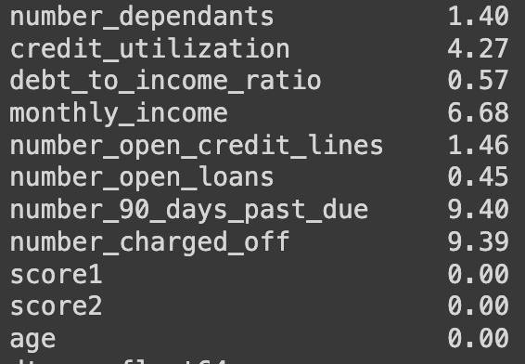
Data Preparation — Outliers
Some models are not robust to outliers, outliers distort model coefficients.
methods case by case:
Delete: if those are caused by error, model is sensitive to outliers.
Keep: impute with mean, group all outliers into one group increasing model stability.
monthly_income -> monthly_income_group
group income into 3 quantiles as low(0), medium(1) and high income(2)
number_90_days_past_due -> number_90_days_past_due_ind
number_charged_off -> number_charged_off_ind
Outlier percentage based on IQR
Notes:
correlation - no multicollinearity

Slide 6
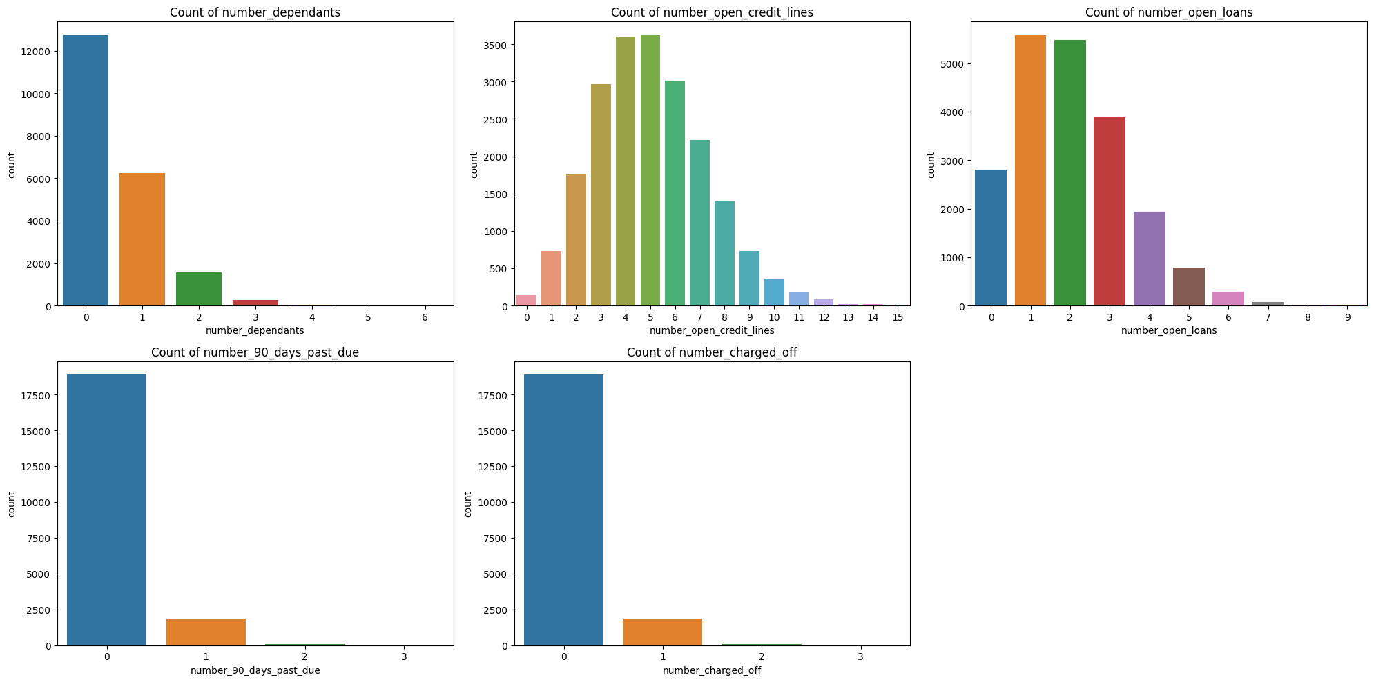
Data Exploration — Distribution
number_dependants: majority of customers has 0 or 1 dependants.
number_open_credit_lines: right skewed. The majority customers has 3 to 6 open credit lines.
number_open_loans: right skewed, and the majority customers has 1 or 2 open loans.
number_90_days_past_due & number_charged_off: majority customers never past 90 days due and never charged off.
Notes:
goal:
- understand the data: what is available, what is the distribution and range
- intuition of relationship between independent and dependent variables, useful for feature selection and engineering
number_open_credit_lines:
- having too few or too many open credit lines could be associated with different risk profiles: too few->limited credit history, too many->higher risk for missed payments. So it is important to to analyze in conjunction with other variables.

Slide 7
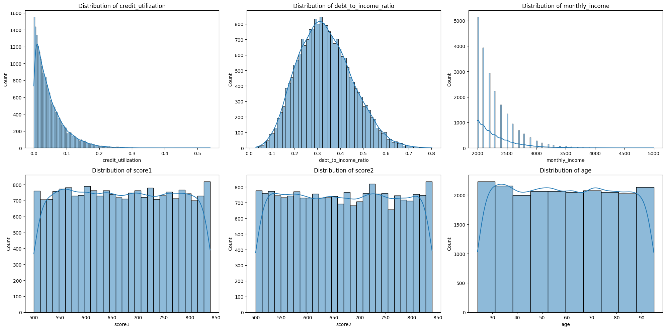
Data Exploration — Distribution Cont.
credit_utilization: right skewed; majority customers credit utilization is below 0.1.
debt_to_income_ratio: approximate normal distribution. The mean is around 0.3.
monthly_income: right skewed. majority customers income is below $2500.
score1 & score2: approximate uniform distribution.
age: approximate uniform distribution.
Notes:
credit_utilization: exponential decrease.
monthly_income: consider with other factors

Slide 8
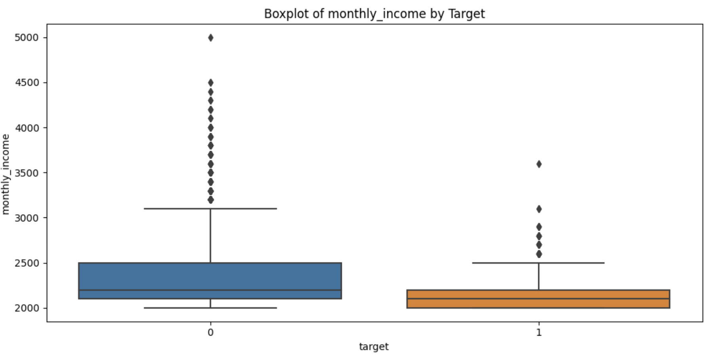
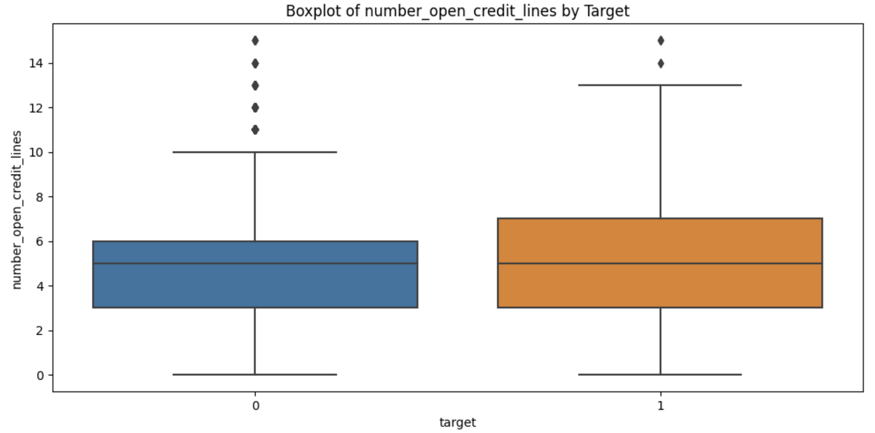
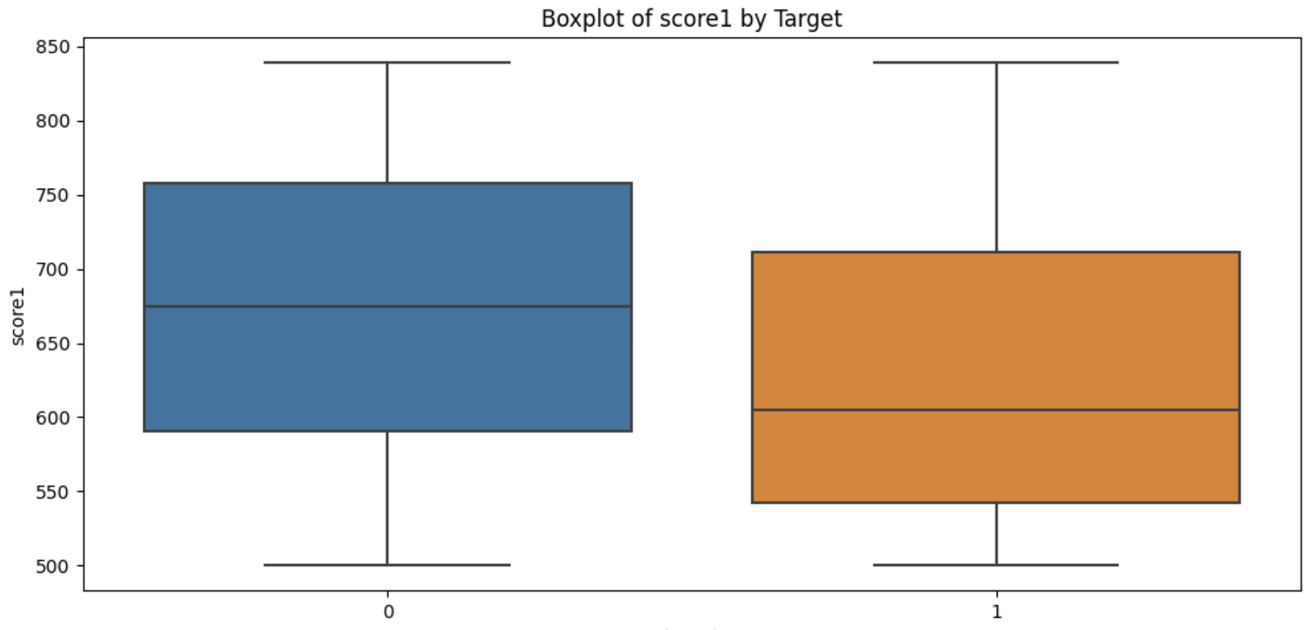
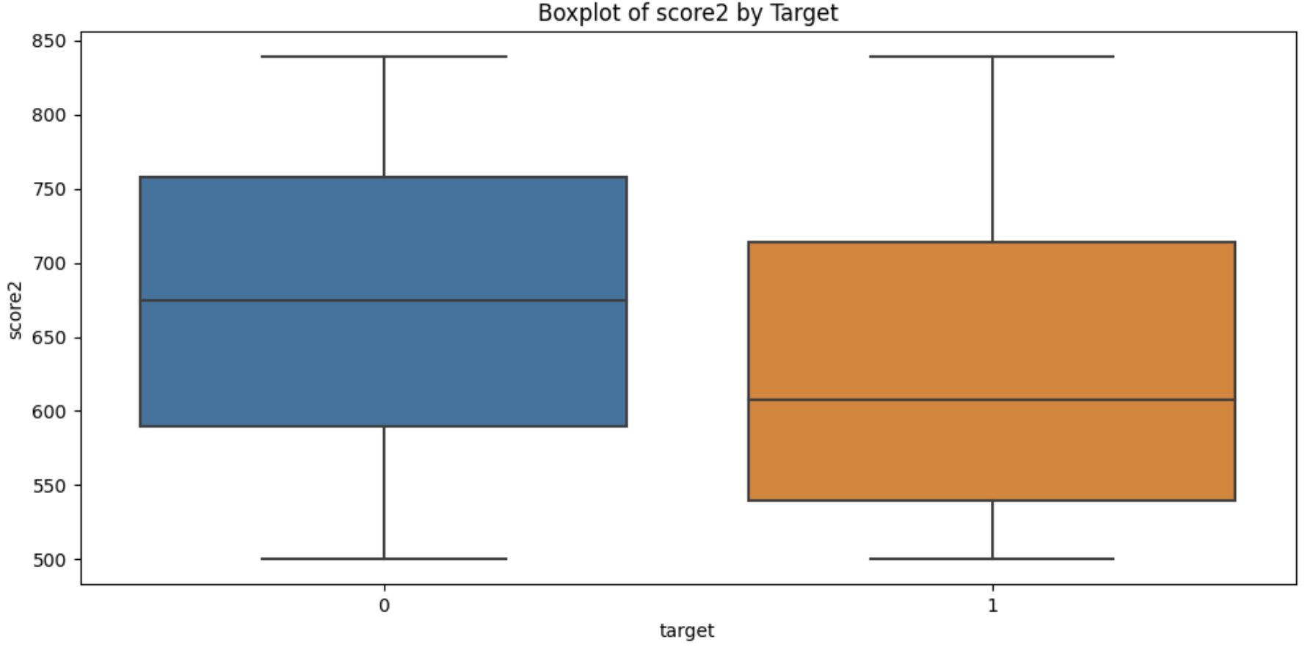
Data Exploration —Boxplot
monthly_income: non-default customers has high monthly income.
number_open_credit_lines: default group has high variance than non-default group.
score1 & score2: non-default has lower score1 and score2.

Slide 9
New Features
Indicators:
90_days_past_due_ind: a binary indicator for whether the borrower has ever been 90 days past due. This feature can address outlier issue.
charged_off_ind: a binary indicator for whether the borrower has ever had a charge-off. This feature can address outlier issue.
Binning group
monthly_income_group: group income into 3 quantiles as low(0), medium(1) and high income(2). This feature can address outlier issue.
Interaction:
income_per_household: income/(number_dependants+1).
credit_utilization_total: credit_utilization * number_open_credit_lines.
Notes:
not use PCA:
- loss of interpretability, transparency,
- require linearity assumption
income_per_household: is useful for understanding the financial resources available per person in the household
credit_utilization_total: useful for understanding an individual's overall reliance on credit

Slide 10
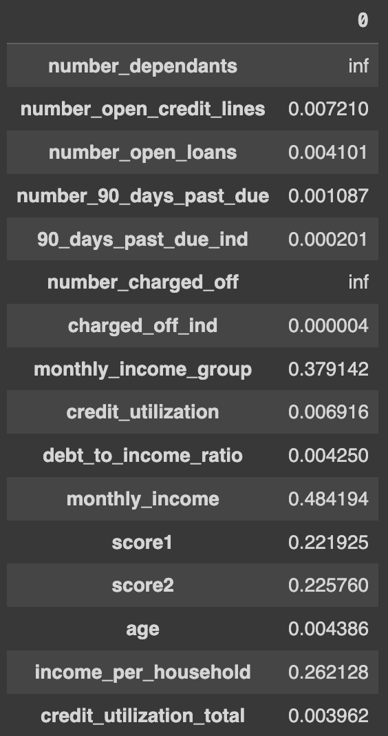
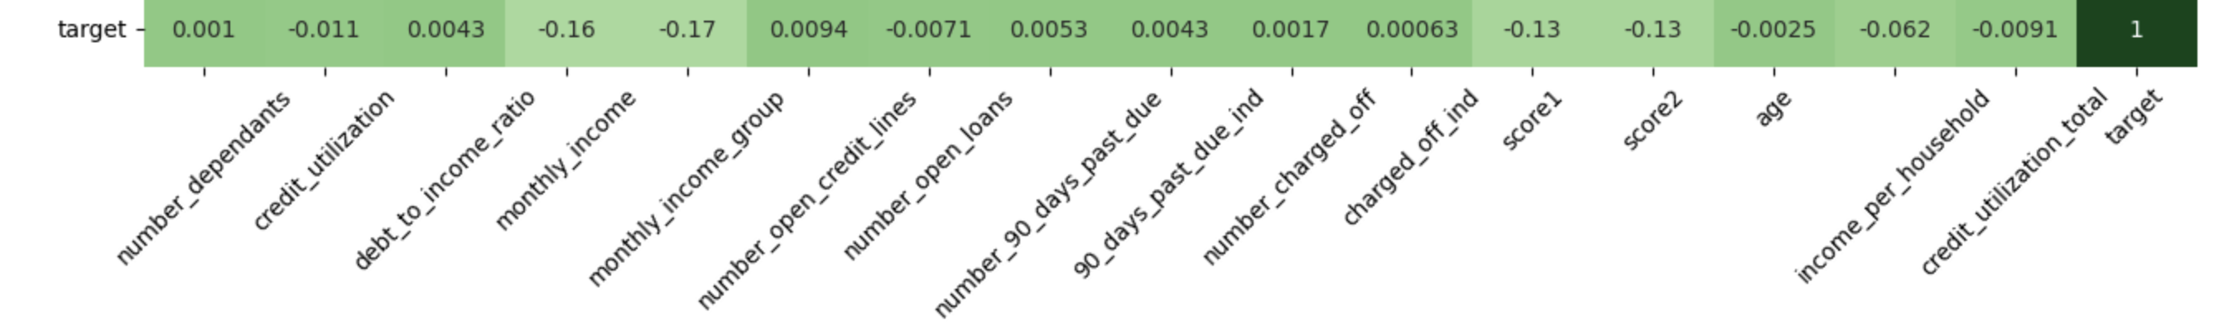
Feature Selection
IV values table
Based on correlation, IV, random forest classifier, boxplots
Select: ’score1’, ’score2’, ‘monthly_income_group’, ‘credit_utilization’, ‘debt_to_income_ratio’, ‘age’
Methods | Selected Variables
Filter: IV | ‘monthly_income_group’, ‘monthly_group’, ‘score1’, ‘score2’, ‘income_per_hoursehold’
Filter: Correlation | ‘debt_to_income_ratio’, ‘monthly_income’, ’score1’, ’score2’
Model-based: Random Forest Classifier | 'credit_utilization', 'debt_to_income_ratio', 'score1', 'score2', 'age‘, 'credit_utilization_total’
Boxplots | ’monthly_income’, ‘score1’, ‘score2’
Correlation with Target
Notes:
Filter methods:
-statistical test
-variance threshold
Wrapper methods:
- stepwise selection
Model-based:
- l1, l2 regularization

Slide 11
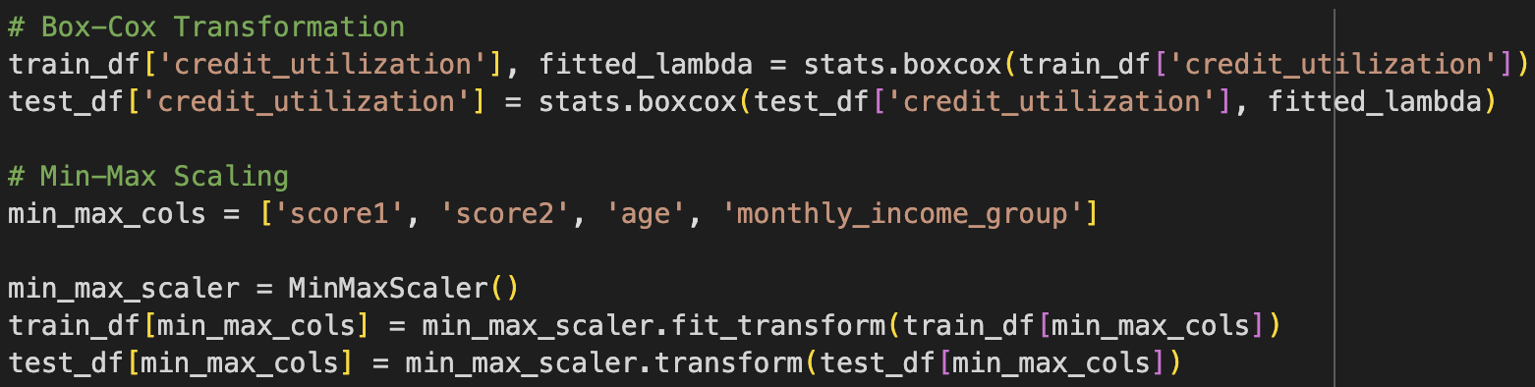
Scale
BoxCox transformation for skewed distribution.
credit_utilization
Standardization for normal distribution.
Min_Max no require for distribution, only change range.
score1, score2, age, monthly_income_group
For both train and test datasets

Slide 12
Model development
Split training set into X_train, X_valid, y_train, y_valid with random_state = 42, test_size = 0.2.
Also tried oversampling data to deal with imbalance: SMOTE(random_state=42)
Hyperparameters tuning with cross validation, cv=5
Possible evaluation metric:
Accuracy: assumes equal costs for both kinds of errors
Precision: is a good metric when the cost of 'False Positive' is high. In our context, 'False Positive' means loosing a good client.
Recall: is a good metric when the cost of 'False Negative' is high. In our context, 'False Negative' means approving loan to a client when there is chance of defaulting
Average precision: the area under the PR curve.
F1_score: harmonic mean of precision and recall
AUC_ROC: power of the classifier, how much model is capable of distinguishing between classes. Usually range between 0.5 to 1

Slide 13
Model Hyperparameter Tuning
Model Name | Model Type | Hyperparameters
Random Forest* | Tree-based | n_estimators, max_depth, min_samples_split, min_samples_leaf, bootstrap
Decision Tree* | Tree-based | criterion, max_depth, min_samples_split, min_samples_leaf
Logistic Regression* | Linear | penalty
KNN | Non-parametric | n_estimators, weights, metric
XGBClassifier* | Tree-based | n_estimators, learning_rate, max_depth, min_child_weight, subsample, colsample_bytree
AdaBoostClassifier* | Tree-based | n_estimators, learning_rate, algorithm
* class_weight = ‘balanced’ Hyperparameters setting detail is in python file
Reason for not develop deep learning model: not easy to interpret feature impact to model result
Support Vector Machine (SVM):
C: penalty. Inverse of regularization strength
Kernel: ‘linear’ for linear separable data; ‘RBF’ for non-linearly separable data
Random Forest:
n_estimators: number of trees.
Logistic Regreesion:
C: penalty. Inverse of regularization strength
Decision Tree:
criterion: ‘gini’ and ‘entropy’
KNN:
n_neighbors: 3, 5, 11, 19
weights: ‘uniform’, ‘distance’
metric: ‘euclidean’, ‘manhattan’
Notes:
more models can try: Neuron network

Slide 14
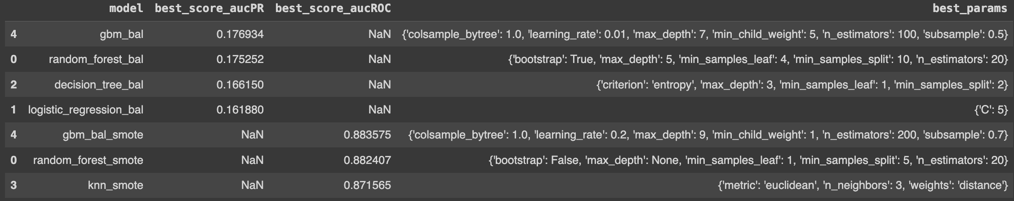
Model development
Original dataset: average precision is used to tune hyperparameters since it combine precision and recall which emphasis positive class.
ROC-AUC affected by negative class in imbalanced dataset.
SMOTE dataset: ROC-AUC is used to tune hyperparameters
Result:
Select top models with similar performance from both datasets.
In both datasets, xgboost and random forest performs better.

Slide 15
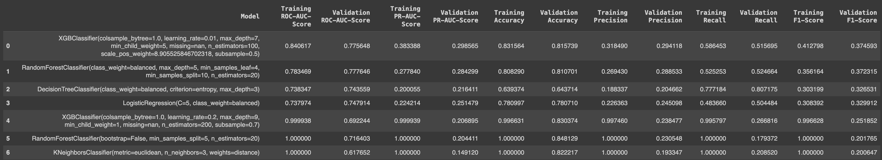
Model Evaluation Step
Fit in training set with hyperparameters select from GridSearch.
Select optimal threshold from the best f1 score.
Predict the testing set with optimal threshold.
Compare ROC-AUC, average precision, accuracy, precision, recall, and f1 score.
Model | Hyperparameters | AUC | F1
Logistic Regression | C = 5 | 0.75 | 0
SVM with balance weights | C = 20, kernel = ‘rbf’ | N/A | 0.33
Random Forest | n_estimators = 1 | 0.57 | 0.23
Random Forest with balance weights | n_estimators = 1 | 0.54 | 0.18
Decision Tree | criterion='entropy' | 0.55 | 0.19
Decision Tree with balance weights | criterion=gini' | 0.54 | 0.17

Slide 16
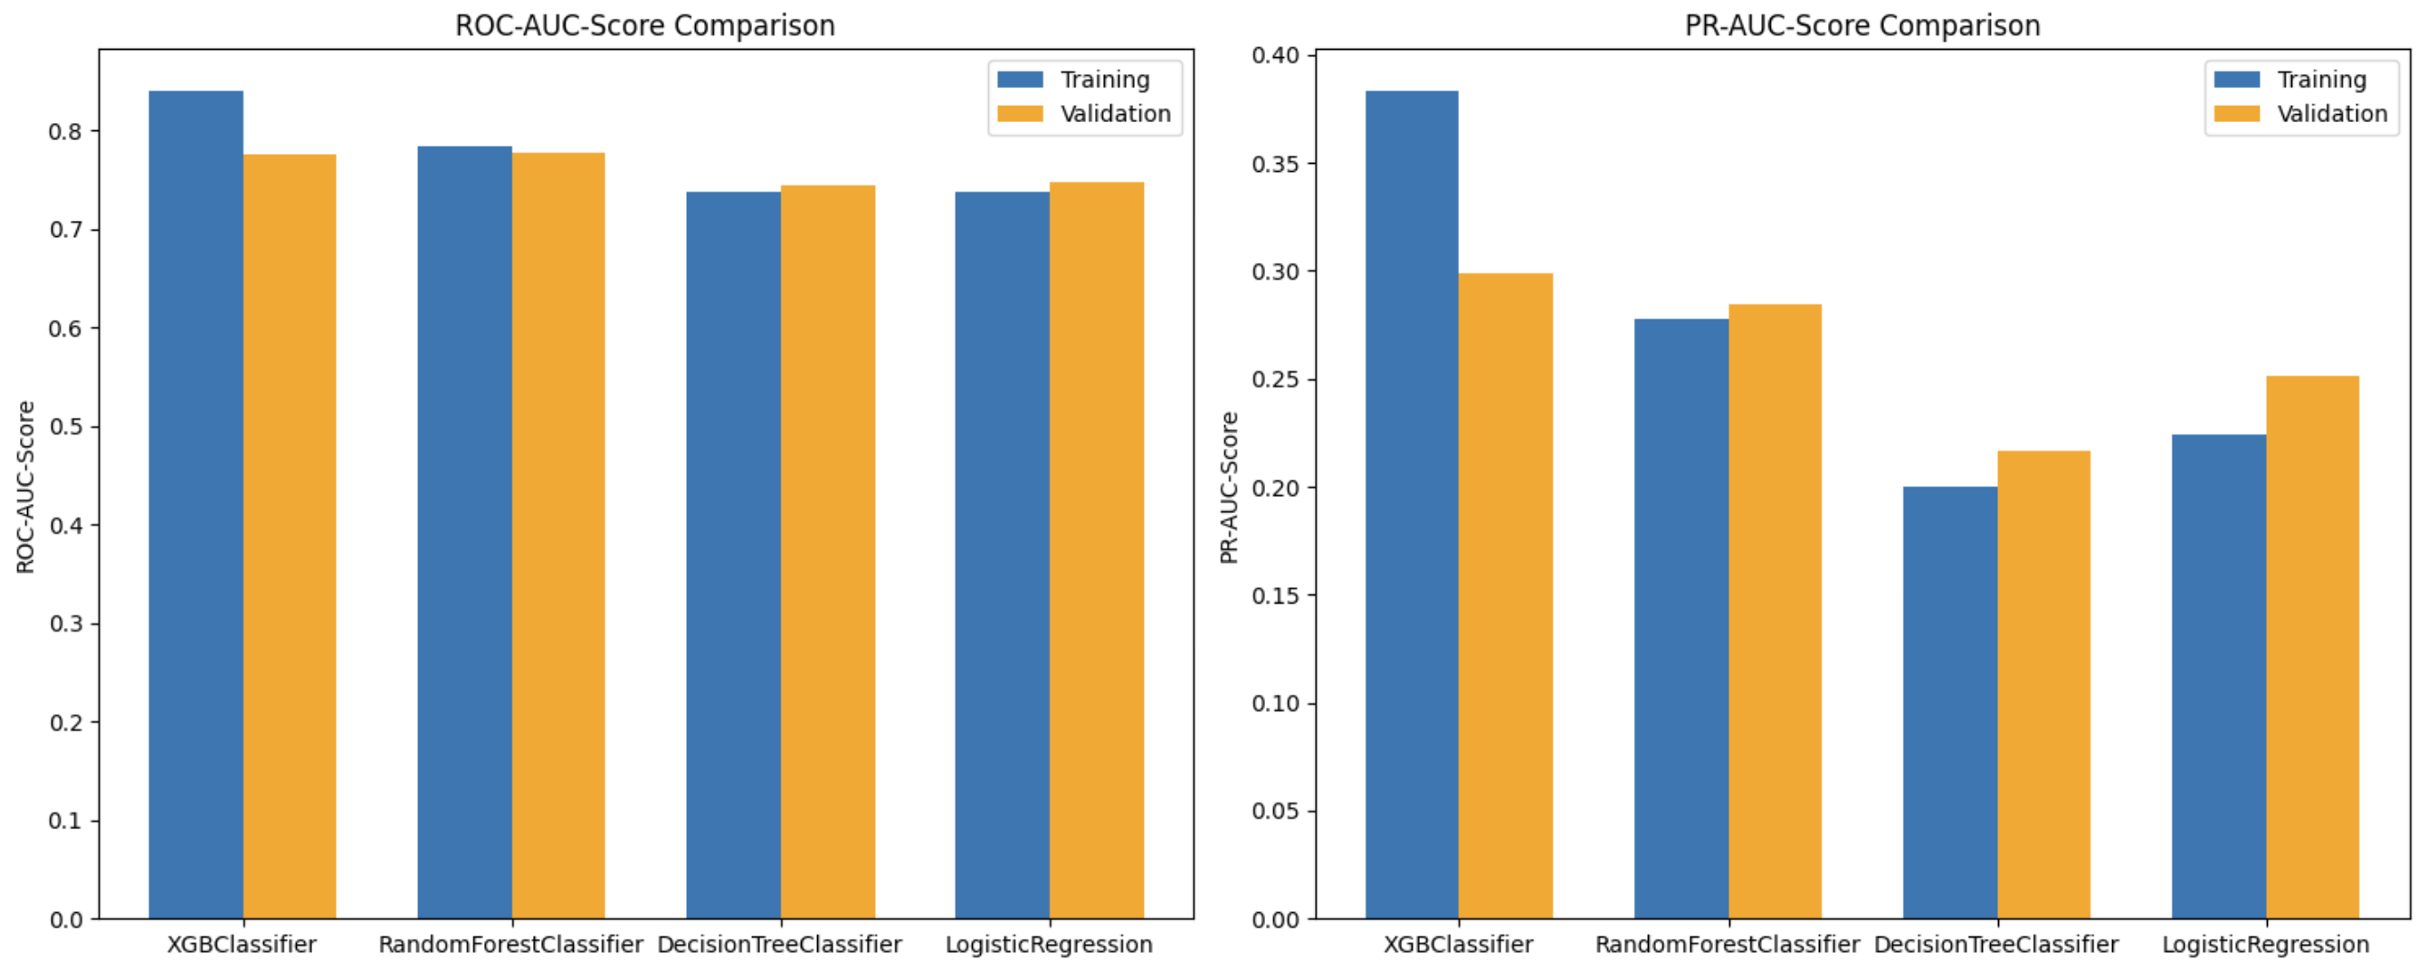
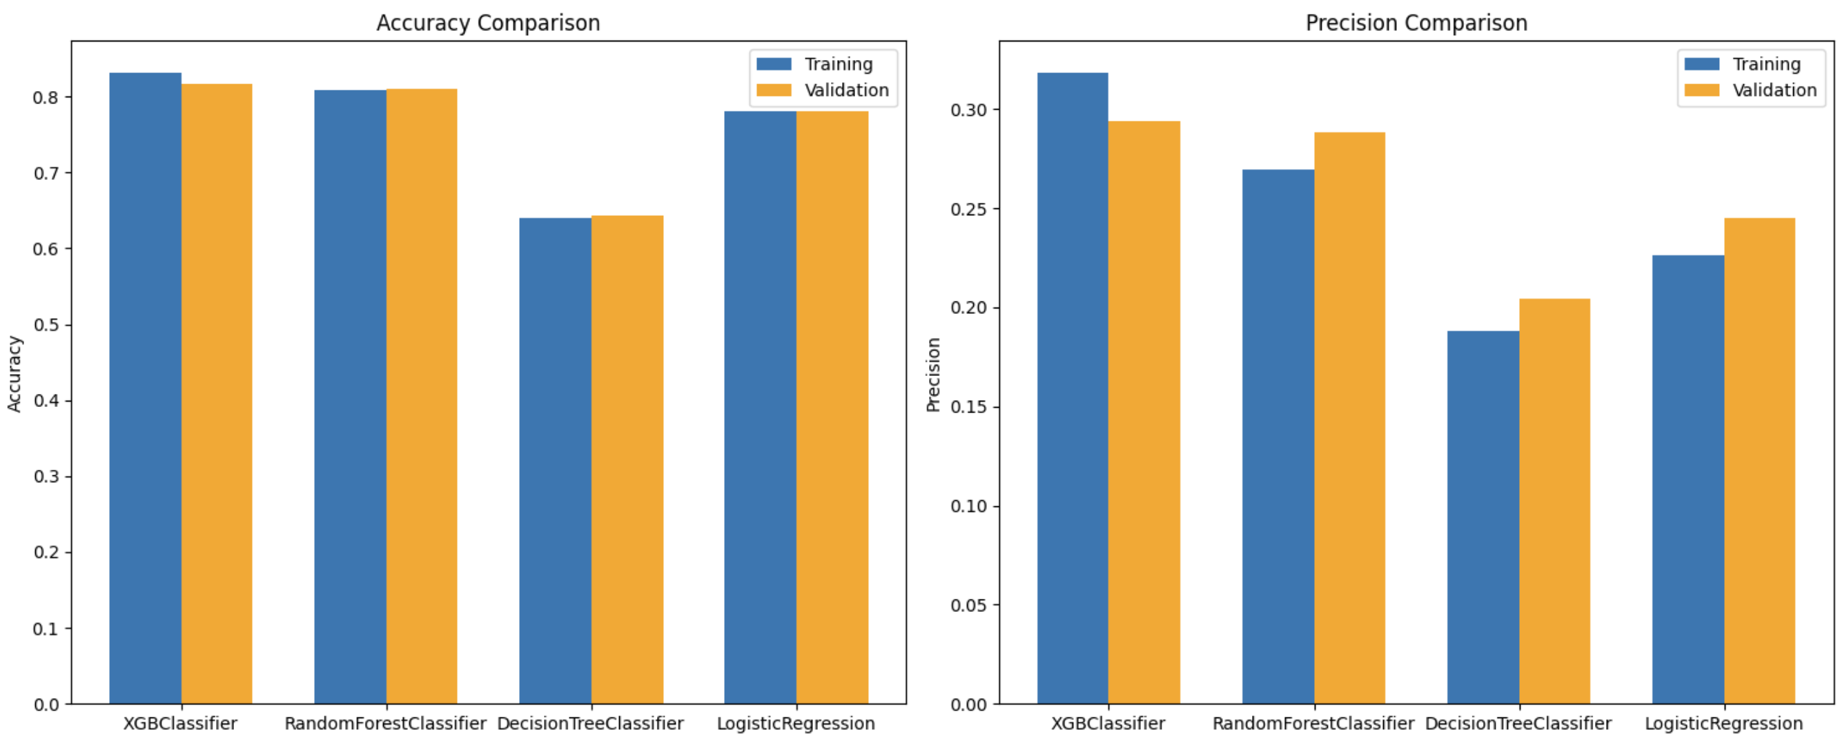
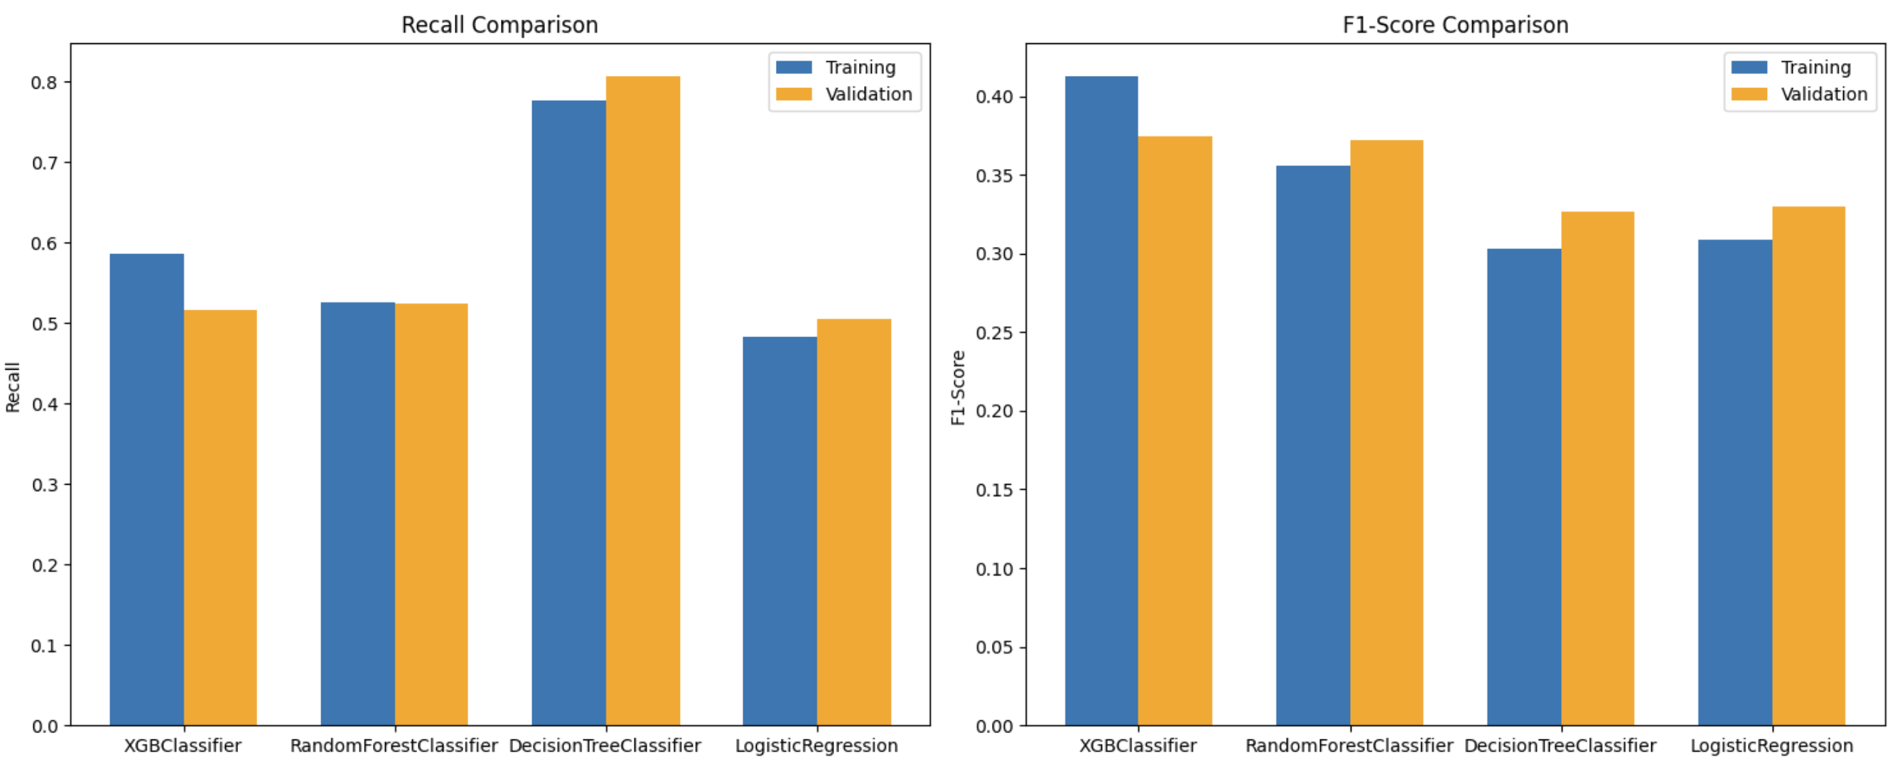
Model Evaluation Result
All models trained with SMOTE dataset are overfit which indicate the synthetic samples not represent underlying representation.
XGBoost and Random Forest have similar performance considering all the metrics.
Random Forest as final model reasons:
Interpretable and easily visualize than XGBoost
Computational efficient than XGBoost
Can handle missing values inherently
Apply random forest with total train set and select optimal threshold given best f1-score. Then predict test set.

Slide 17
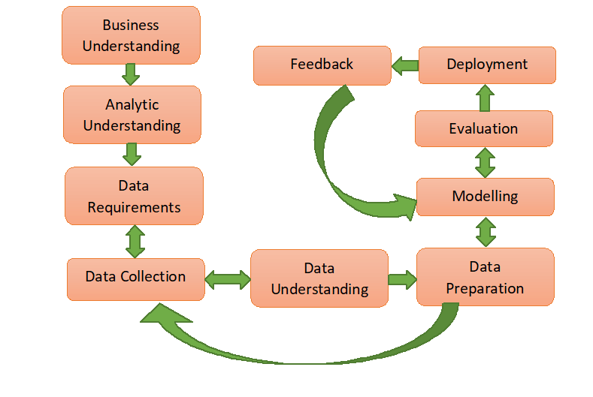
Furthermore
Try different oversample methods and combine with undersample models
Collect more data:
employment info
loan info: purpose, amount, interest rate if applicable
more demographic info: education, marital status
Monitoring real-time data distribution preventing model drift

Slide 18
Q&A

